Slide 1
RELATIONAL ALGEBRA

Slide 2
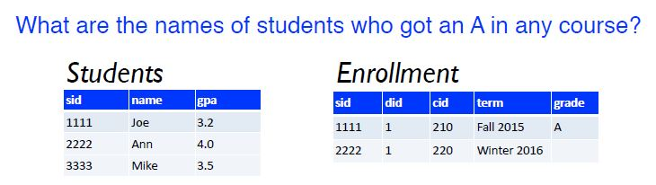

Slide 3
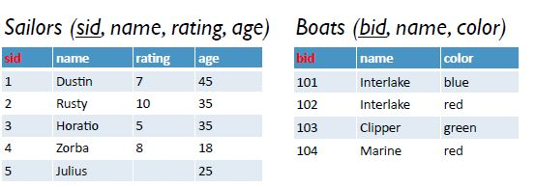
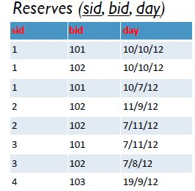

Slide 4
List names of boats.
List ratings and ages sailors
List names of sailors who are over 21 years old.
List names of red boats.
List ids of boats named Interlake.
List ids of boats reserved on 10/10/12
List ids of sailors who reserved boat 102
List names of sailors who reserved boat 102

Slide 5
9. List names of sailors who reserved the red Interlake.
10.List names of boats that were reserved by
Horatio.
11. List days on which some sailor with rating
higher than 7 was at sea
12. List names and colors of boats that were reserved by Zorba

